Slide 1
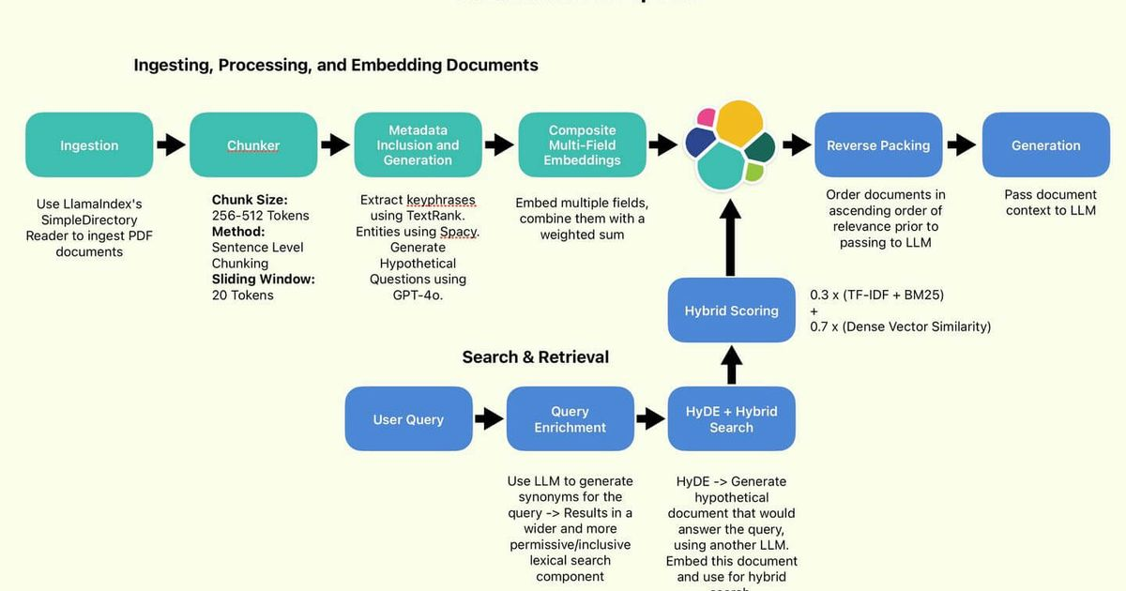
Module 4 – Advanced RAG & Vector Engineering
Goal: Eliminating hallucinations and ensuring document traceability.
The Problem: Standard RAG often misses context or retrieves "noisy" data that confuses the model.
The Solution: Advanced Vector Engineering (Hybrid Search + Reranking) and Agentic reasoning.

Slide 2
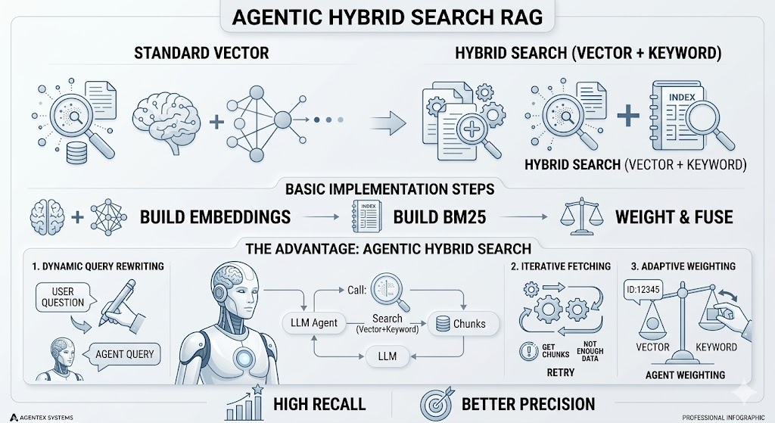
Hybrid Search & Agentic RAG
Hybrid Search: Combining Keyword (BM25) for exact matches (like serial numbers or medical terms) and Vector Search for semantic meaning.
Agentic RAG: Instead of a single "retrieve and answer" step, the agent can look at the results and say: "This isn't enough information. I will try a different search query."

Slide 3
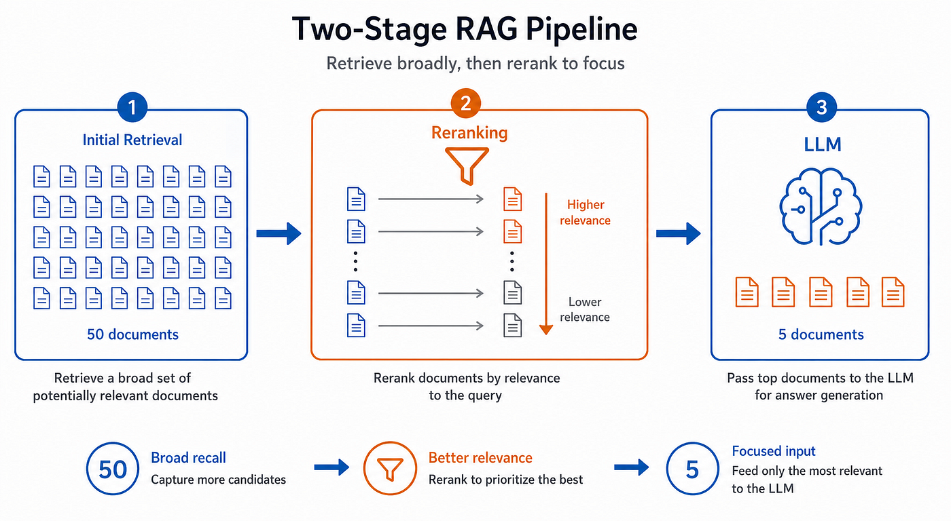
Reranking & Evaluation
Reranking: Using a Cross-Encoder to analyze the top 50 results and pick the best 3. It’s slower but much more accurate than a standard vector search.
RAGAS Framework: Using AI to grade the AI. We measure:
Faithfulness: Is the answer derived only from the context?
Relevancy: Does it actually answer the user's question?
Task 4 Deliverable: A "Memory Vault" that provides answers with specific citations (e.g., "Source: manual.pdf, Page 12").

